Slide 1
PROJECT REPORT OF SUMMER
INTERSHIP
TOPIC:- SOP for ITR (Income Tax)
Submitted to:- Shashwat Singhal
Submitted by:Unnati Chaurasia

Slide 2
INTRODUCTION
What is Income Tax?
Income Tax is a direct tax levied by the government on the income earned by individuals, businesses, firms, companies, and other entities during a financial year. It is one of the most important sources of revenue for the government and is used to finance public services, welfare schemes, and national development projects.
In India, income tax is governed by the Income Tax Act, 1961 (with reforms and simplification efforts through the Income Tax Bill, 2025).

Slide 3
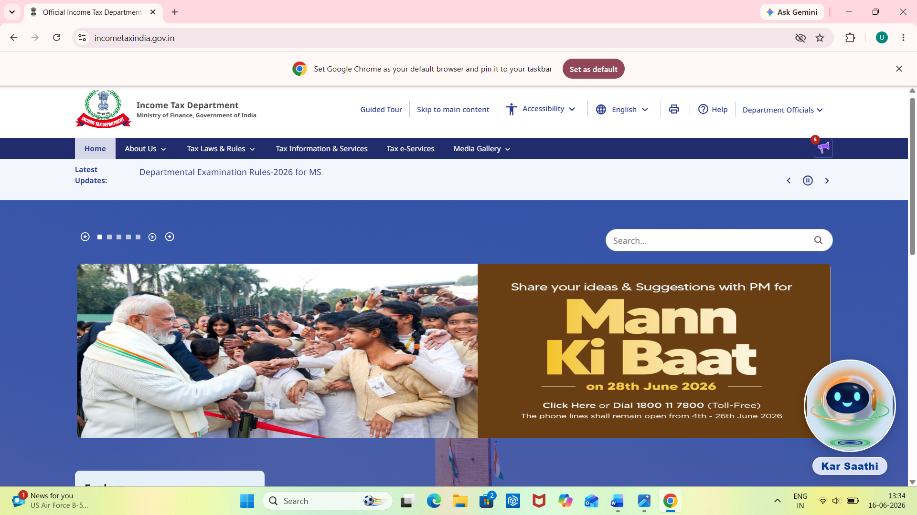
OBJECTIVES OF INCOME TAX
Generate Government Revenue
Reduce Income Inequality
Economic Development
Resource Redistribution
Economic Stability

Slide 4
(ITR) INCOME TAX RETURN
Income Tax Return (ITR) is a form prescribed by the Income Tax Department of India that taxpayers use to report their income, expenses, deductions, tax liabilities, and taxes paid during a financial year. It is filed annually with the Income Tax Department.
In simple words, an ITR is a statement through which an individual, business, firm, or organization informs the government about its earnings and pays the required tax

Slide 5
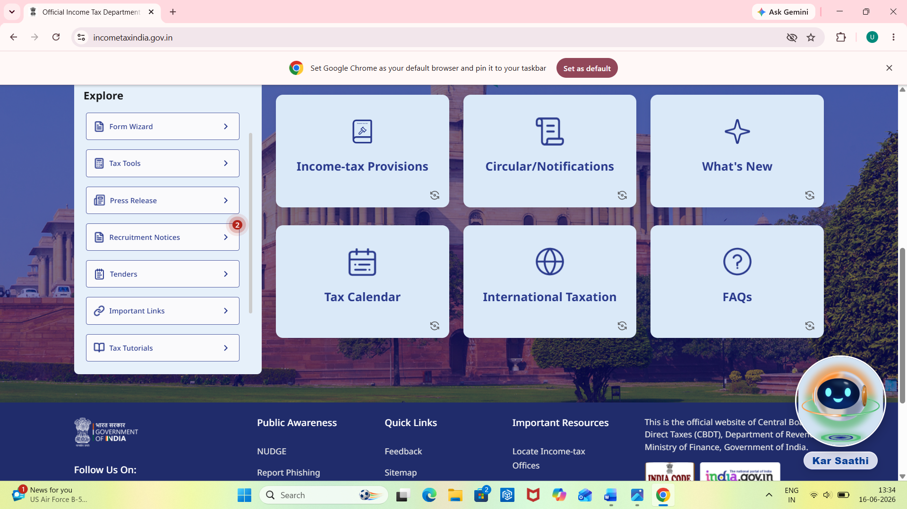
IMPORTANCE OF ITR
Legal Compliance
Proof of Income
Loan Approval
Visa Processing
Tax Refund

Slide 6
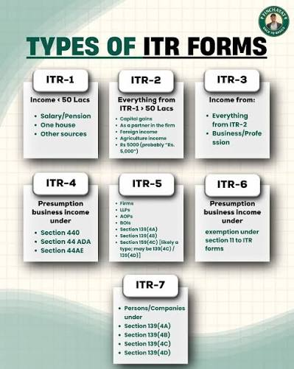
TYPES OF ITR
ITR-1 (Sahaj)
ITR-2
ITR-3
ITR-4(Sugam)
ITR-5
ITR-6
ITR-7

Slide 7
TYPES OF PERSONS
Individuals
Hindu Undivided Family (HUF)
Firm
Company
Local Authority
Artificial Juridical Person(AJP)
Association of Person & Body of Individual (AOP & BOI)

Slide 8
HEADS OF INCOME
Income from Salary
Income from House Property
Profit and Gains from Business or Professions
Capital Gains
Income from Other Sources

Slide 9
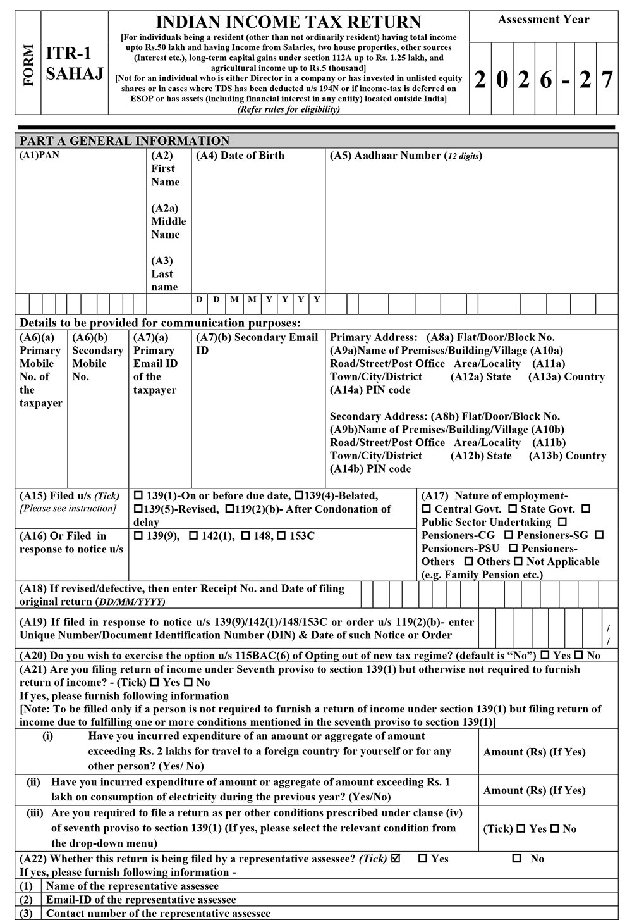
HOW TO PREPARE ITR-1 (SAHAJ)
Step 1: Collect Required Documents
Step 2: Calculate Total Income
Step 3: Claim Deductions
Step 4: Compute Taxable Income
Step 5: Verify Taxes Paid
Step 6: Login to Income Tax Portal
Step 7: Select ITR-1
Step 8: Fill the Details
Step 9: Validate and Submit
Step 10: Verify the Return

Slide 10
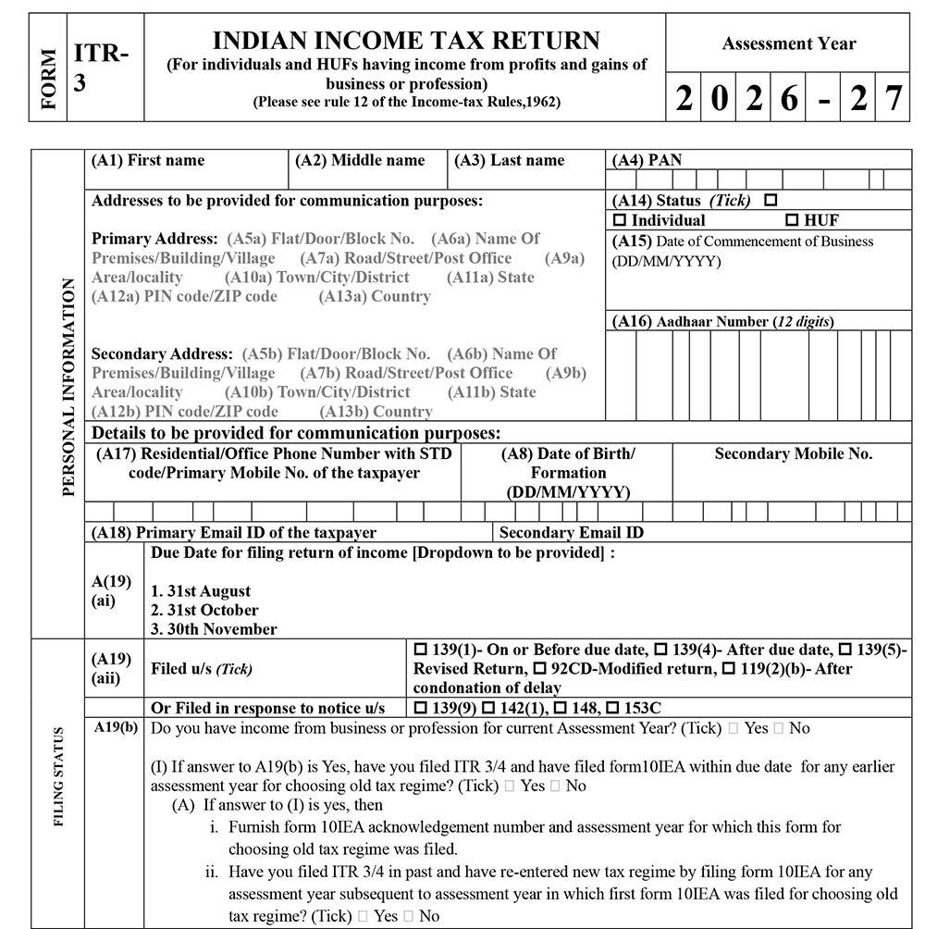
HOW TO PREPARE ITR-3
Step 1: Collect Required Documents
Step 2: Calculate Total Income
Step 3: Prepare Financial Statements
Step 4: Compute Business Income
Step 5: Claim Deductions
Step 6: Calculate Tax Liability
Step 7: Fill ITR-3 Form
Step 8: Verify the Return

Slide 11
NEW TAX REGIME AND OLD TAX
REGIME
The New Tax Regime was introduced to simplify income tax by offering lower tax rates but removing most deductions and exemptions.
Features
Lower tax rates.
Most deductions and exemptions are not allowed.
Simpler tax calculation.
No need to invest just for tax saving.
The Old Tax Regime allows taxpayers to claim various deductions and exemptions to reduce their taxable income.
Features
Allows deductions under Section 80C (PPF, LIC, ELSS, etc.).
Allows deduction under Section 80D (Health Insurance).
Allows House Rent Allowance (HRA) exemption.
Allows Leave Travel Allowance (LTA) exemption.
Allows deduction on Home Loan Interest.

Slide 12
CONCLUSION
Income Tax is an important source of government revenue and helps in the country's development. The Income Tax Return (ITR) is used to report income and pay taxes. Different ITR forms are available for different taxpayers, and income is classified under various heads. Proper preparation of ITR-1 and ITR-3 ensures accurate tax filing. The Old Tax Regime offers deductions and exemptions, while the New Tax Regime provides lower tax rates with fewer benefits. Timely and correct filing of ITR helps in tax compliance, claiming refunds, and maintaining financial transparency.

